Slide 1
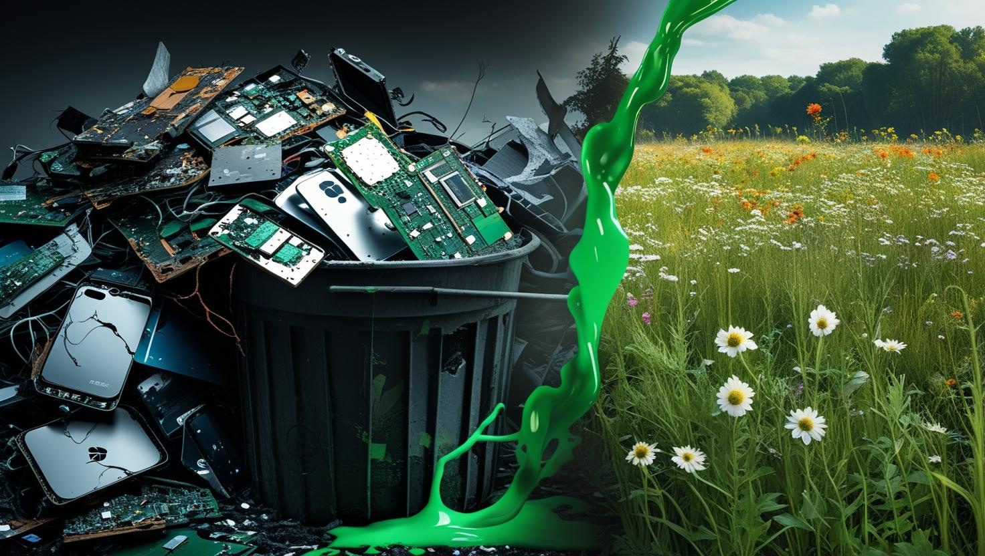
Electronic Waste
Are you sure you are not part of the problem?
Maria Kokkaliari
Informatics and Telecomunication Engineer
Presentation of Personal research
Electronic Waste - Circular Economy

Slide 2
Defining Electronic Waste
🔷Electronic waste (e-waste) = Discarded Electrical or Electronic Devices
🔷Also called Waste Electrical and Electronic Equipment (WEEE)
🔷Contains valuable materials + hazardous substances

Slide 3
Most Common Electronic Devices and Appliances
📱 Consumer Electronics
Smartphones, tablets, laptops, desktop computers
Televisions, monitors, game consoles, printers
Cameras, audio equipment, wearables (smartwatches)
🏠 Household Appliances
Refrigerators, washing machines, dryers
Microwaves, ovens, coffee machines, vacuum cleaners
Air conditioners, heaters, lighting equipment
🌐 Network & IT Infrastructure
Routers, switches, modems, wireless access points
Servers, data storage units, optical transceivers
Power distribution units (PDUs), backup batteries (UPS systems)
🏭 Industrial Equipment
Control panels, programmable logic controllers (PLCs)
Electric motors, drives, sensors
Industrial robots, automation systems
Telecommunication towers, base stations
🏥 Medical Infrastructure
Diagnostic devices (MRI, CT scanners, X-ray machines)
Patient monitors, infusion pumps, ventilators
Laboratory analyzers, centrifuges, microscopes
Hospital IT systems (servers, imaging storage, networked devices)

Slide 4
Composition & Risks
Valuable resources: Au, Ag, Cu, Pd, REEs, plastics, glass
Hazardous materials: Pb, Hg, Cd, As, BFRs, PCBs, PAHs
Health risks: respiratory, neurological, reproductive, cancer

Slide 5
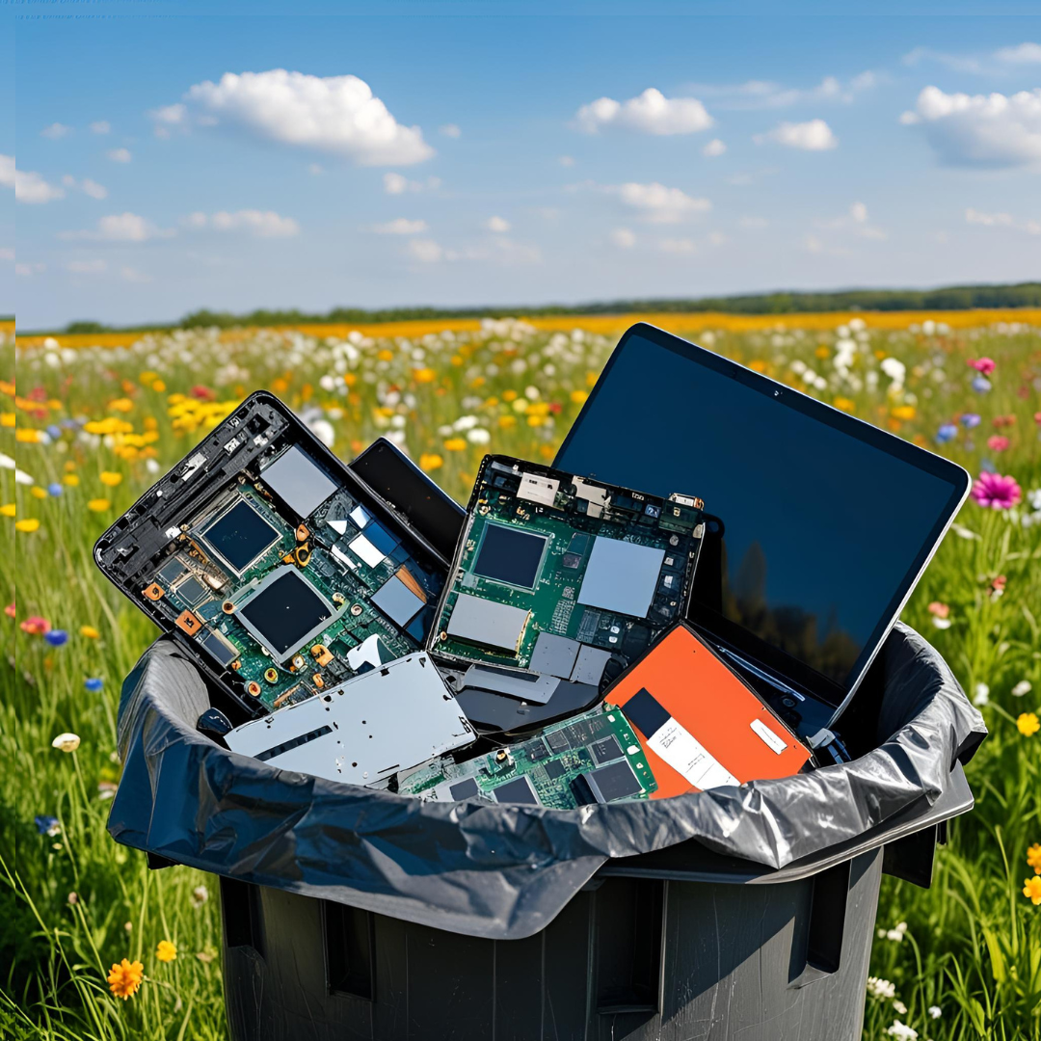
Where do old electronics end up after disposal?

Slide 6
Destinations of E-Waste
E-Waste Disposal
Formal Recycling Facilities
Informal Recycling / Backyard Processing
Landfills & Dumpsites
Export / Transboundary Movement
Incineration & Waste-to-Energy
Storage / Dormancy
Circular Economy Methods

Slide 7
Recycling Solutions
Mechanical separation: shredding, sorting
Hydrometallurgy: selective metal extraction
Pyrometallurgy: bulk recovery, high energy cost
Bioleaching: microbes extract metals, eco-friendly
Robotics & AI: automated sorting, safer disassembly

Slide 8
CIRCULAR ECONOMY STRATEGIES OF E WASTE
Refurbishment – highest value retention
Remanufacturing – factory-grade rebuilds
Repurposing a device-Same device with different function
Recycling – material recovery but low value retention
Reuse/Maintenance for Reuse - give the device a second chance
Circular Economy (CE) framework designed to maximize value retention and minimize waste across the electronics lifecycle. The main CE strategies include:

Slide 9
The Refurbishing Model
Refurbished devices are pre-owned items restored to like-new condition
Undergo testing, repairs, and quality checks
Often include warranty and new packaging

Slide 10
Functional hardware and updated software
Professionally cleaned and inspected
May include replaced components (e.g., battery, screen)
Basic Features

Slide 11
Example
👤 A user owns an old laptop and wants it refurbished
📦 They send the device to a refurbishment center
🔍 It’s inspected and sorted: repairable or not
🛠️ Repairable devices are fixed, cleaned, and updated
🧪 All refurbished devices go through testing and quality control
🚚 The user receives a fully refurbished device
P♻️ Unrepairable parts are responsibly recycled

Slide 12










Refurbishing Center
Inspection process
The Refurbishing model
Faulty Device
Non repairrable
Repairable
Recycling Process
User
Quality testing control
Refurbished Device

Slide 13
Pros and Cons
✅ Lower cost than new devices
✅ Environmentally friendly (less e-waste)
✅ Often include warranties
❌ May show minor surface signs of previous use and imperfections
❌ Shorter lifespan compared to new
❌ Availability may vary by model

Slide 14
The Repurposing Model
Repurposing refers to reusing an old or obsolete electronic device for a new function different from its original purpose.
A sustainable practice that extends a device's useful life and reduces e-waste.
Common in DIY tech, circular economy initiatives, and low-cost innovations.

Slide 15
Basic Features
Utilizes existing hardware
Avoids disposal or recycling
Supports sustainable tech use
Often involves creative adaptation
Low or no cost to implement
Often requires apps or software reconfiguration

Slide 16
Example
👤 A user owns an old moblile device
🧹 He executes a reset to wipe all data
📲 Downloads the applications needed for monitoring
📷🎙️Connects the mobile to the WiFi and sets the camera and microphone on
🏠 Installs the device to the area he wants to monitor
🌍 Access the device remotely for surveillance

Slide 17










Downoload Applications
Device Master Reset
Wifi,Camera and Microphone connection of the device
Faulty or Old Device
The Repurposing Model
Remote Access and Surveillance
Installation and Access

Slide 18
Pros & Cons
✅ Reduces electronic waste by giving old devices a new purpose
✅ Cost-effective: avoids buying new equipment
✅ Environmentally responsible, supports sustainability and circular economy
✅ Encourages creativity and innovation in adapting devices
✅ Extends device lifespan, making the most of existing resources
⚠️ Battery degradation: old devices may have shorter battery life or overheat
⚠️ Hardware limitations: lower resolution, storage, or processing speed
⚠️ Security risks: older devices may lack software updates or patches
⚠️ Setup required: configuring apps and mounts may be time-consuming
⚠️ Limited lifespan: eventually devices fail and need proper disposal

Slide 19
The Recycling Model
Recycling involves breaking down electronic devices into their constituent raw materials, such as metals, plastics, and glass.
Original functionality is lost in the process.
Typically applied to end-of-life electronics that cannot be reused due to damage or obsolescence.
Helps recover valuable materials for use in new products.

Slide 20
Basic Features
Breaks devices into raw materials (metal, plastic, glass).
Destroys the original product functionality.
Requires industrial processing and energy.
Focuses on material recovery, not product reuse.

Slide 21
Example
👩User discards an old device to recycling
📱♻️ The device goes to the Recycling Unit where it is dismandled and sorted into recyclable and non recyclable waste
🔧The recyclable materials are used into making new device parts
📱The new device parts are used to make devices
🎁The user purchases a new device

Slide 22
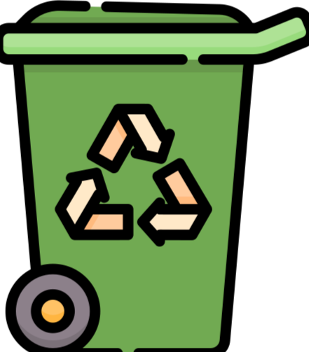





Non recyclable waste
E Waste
Processing Unit
Recyclable waste
Process of recycling
E Waste materials
Old Electronic Device
Electronic Parts Sorting and Subsystem Assembly Unit
New Device
User
New Devices

Slide 23
Pros and Cons
✅ Recovers valuable raw materials
✅ Reduces demand for virgin resources
✅ Prevents hazardous waste
⚠️ Energy-intensive process
⚠️ Original device functionality is lost
⚠️ Lower value retention compared to reuse

Slide 24
The Reuse & Maintenance Model
Reuse: Using devices or components again without modification, retaining most of their original value.
Maintenance for Reuse: Preparing devices for reuse by cleaning, testing, and minor repairs to maintain functionality at a medium value level.
Preferred when devices are still functional or repairable, minimizing environmental impact.

Slide 25
Basic Features
Maintenance for Reuse
Reuse
Devices used as-is without modifications
High value retention
Minimal processing
Extends device lifecycle
Devices are cleaned, tested, and repaired if needed
Medium value retention
Slight processing required
Ensures safe and functional reuse

Slide 26
Example
👦Father has an old laptop that he no longer needs
🔍 Laptop is inspected and tested to check if it still works
🧼🔧 Basic maintenance is done (cleaning, new battery, software reset)
✅ Laptop is restored and fully functional
👩‍🎓 Laptop is passed on to the child for school projects and learning

Slide 27



Inspection, Repair, Hard Reset
Old device -laptop
Device Updated and ready for use- laptop
Maintenance for Reuse Model
User 1 - parent
User 2 - student

Slide 28
Pros and Cons
✅ High (reuse) or medium (maintenance) value retention
✅ Low environmental footprint compared to recycling
✅ Cost-effective
✅ Extends product life cycle
⚠️ Requires quality checks and testing
⚠️ Devices may be outdated or have limited performance
⚠️ Risk of data security issues if not properly wiped

Slide 29
Life Cycle Assessments (LCA) & Carbon Footprint
Recycling reduces mining but is energy-intensive
LCA identifies environmental hotspots
Bioleaching & automation reduce carbon footprint
Policy & design critical for sustainable outcomes

Slide 30
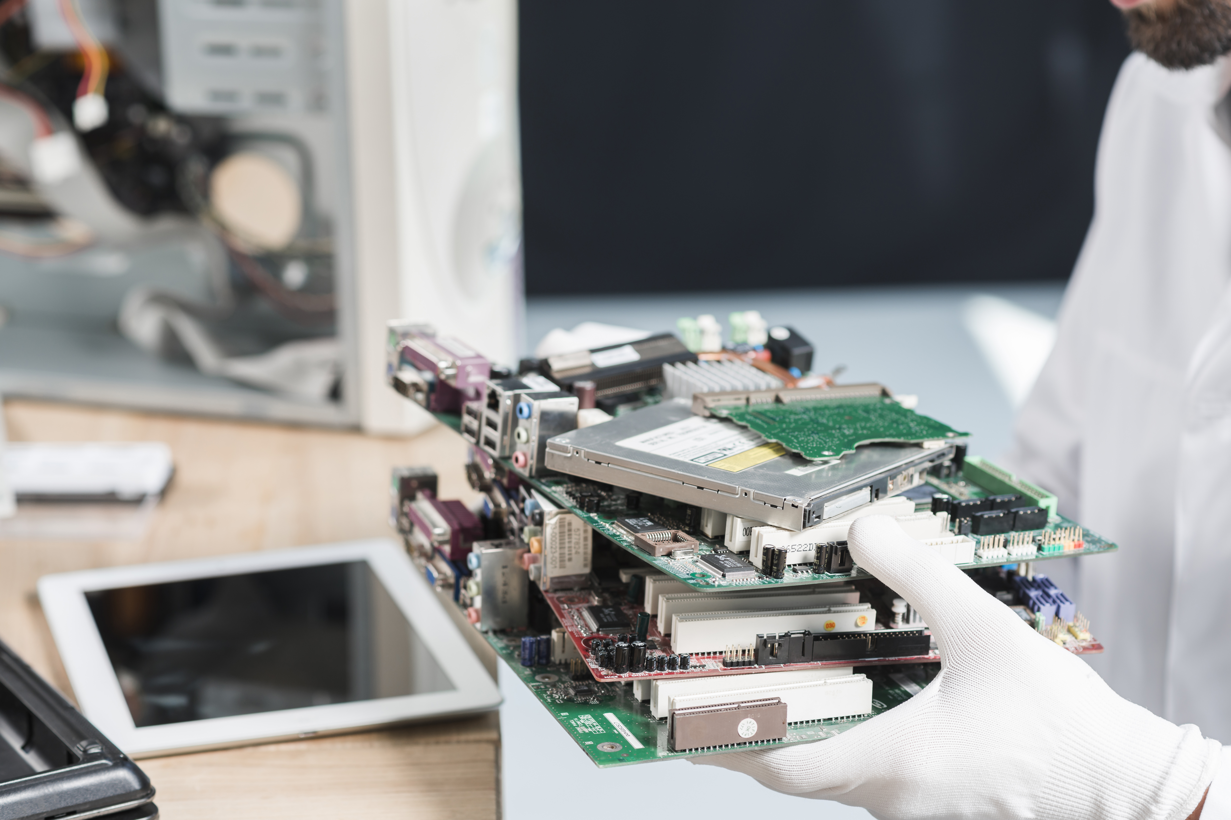
Global E-Waste Overview
62 Mt in 2022 → 82 Mt by 2030
Only ~17.4% formally recycled
Most ends in landfills, informal recycling, or illegal exports
High-income vs. developing nations: huge disparity

Slide 31
Network Infrastructure E-Waste
Switches, routers, servers – high-value waste stream
Premature obsolescence due to tech upgrades
Dense in Cu, Au, Pd → 'urban mines'
Refurbishment & certified recycling reduce impacts

Slide 32
Waste Incineration Process & Materials
MSWI (Municipal Solid Waste Incineration):
High-temperature combustion in grate-fired or fluidized-bed furnaces
Produces heat → electricity & heat via CHP (Combined Heat & Power)
Flue gas cleaning: filters, scrubbers, activated carbon, NOx reduction
Acceptable materials:
Residual MSW, RDF/SRF (non-recyclable plastics, paper, textiles, organics)
Material quality (moisture, ash, heating value) critical for stable combustion
Limitation:
E-waste (WEEE) generally unsuitable → releases toxic dioxins/furans

Slide 33
Pre-Incineration Management
Purpose: improve fuel quality, increase energy efficiency, reduce emissions
Key steps:
Mechanical sorting → remove metals, glass, inert materials
Shredding & screening → control particle size
Drying / biodrying → lower moisture
Quality control: halogen/chlorine testing to avoid dioxin formation
Policies: robust pre-sorting needed to exclude WEEE, PVC-rich plastics, batteries

Slide 34
Pollution, Impacts & Efficiency
Main pollutants: NOx, SO₂, HCl, HF, CO, CO₂, heavy metals, dioxins/furans
Residues:
Bottom ash → can recover metals, reuse in construction
Fly ash → hazardous, needs special disposal/stabilization
Risks: Co-incinerating WEEE plastics ↑ toxic dioxins/furans (Environmental Pollution, 2025)
Efficiency:
MSWI electricity efficiency: 15–30%
CHP systems → raise total efficiency significantly
Takeaway: With advanced APC, sorting & heat recovery, MSWI reduces volume & GHGs vs. landfilling. But WEEE inclusion undermines environmental performance.

Slide 35
Future Strategies
Stronger EPR & repairability mandates
Digital product passports & blockchain traceability
AI & robotics in recycling
Bio-enabled recovery (enzymes, microbes)
Urban mining near data centers
Capacity building in developing regions
Awareness & Education

Slide 36
Conclusion
E-waste: both a hazard and a resource
No single solution – requires systemic, integrated approach - hybrid managing methods
Eco-design + automation + bio-recycling + strong policy
Can transform liability into sustainable resource stream

Slide 37
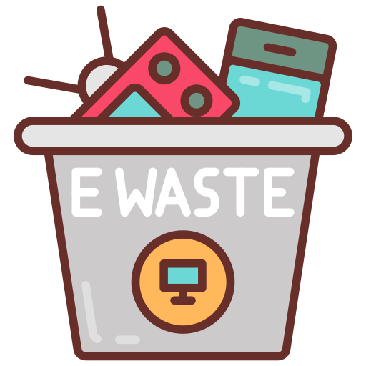
Useful Tools
Icons & Grafics used by flaticon.com
Images with canva.com
Thank you for reading

